Slide 1

Data Visualization Principles
DATA ANALYTICS | IRONHACK

Slide 2

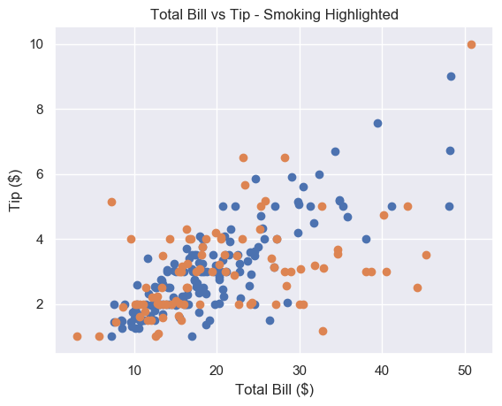
IRONHACK BOOTCAMP
SCATTER PLOTS
They are useful to show the relationship between two numerical variables.

Slide 3
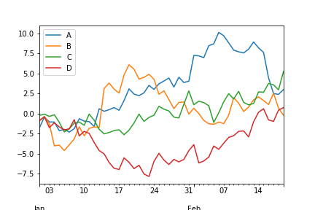
IRONHACK BOOTCAMP
LINE PLOTS
They are used when we want to plot continuous data ( time evolution )
They can contain:
Single series
Two series
Multiple series

Slide 4
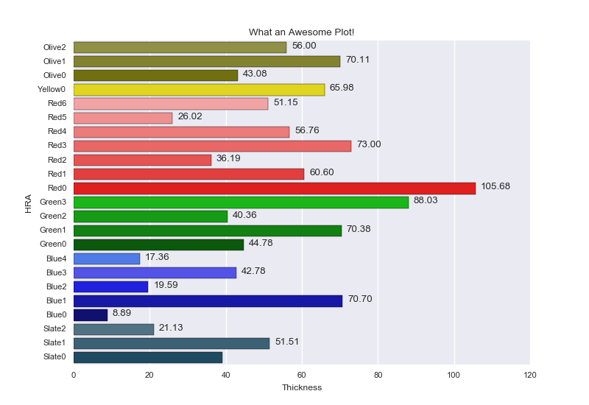
IRONHACK BOOTCAMP
BAR PLOTS
Used to show quantities for categorical data.
Be careful to show a zero baseline!

Slide 5
IRONHACK BOOTCAMP
TEXT
Text tags can reinforce the message.
85%
employment rate

Slide 6
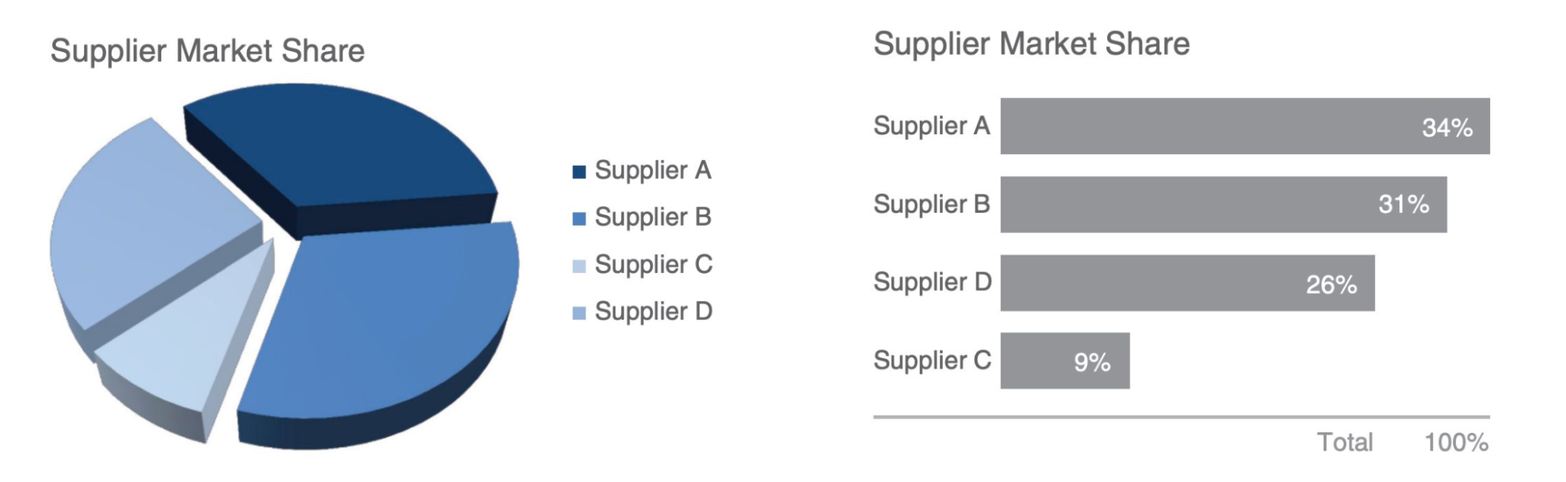
IRONHACK BOOTCAMP
AVOID PIE CHARTS!

Slide 7
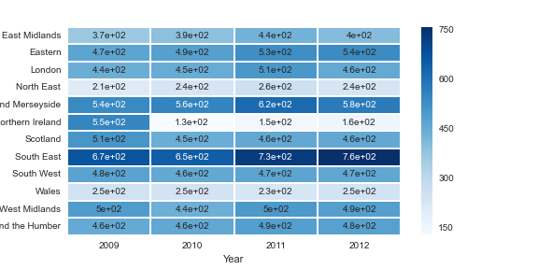
IRONHACK BOOTCAMP
USE CONTRAST TO FOCUS THE ATTENTION

Slide 8
IRONHACK BOOTCAMP
ADDITIONAL READING
Principles of visualization
Datapine

Slide 9


